Slide 1
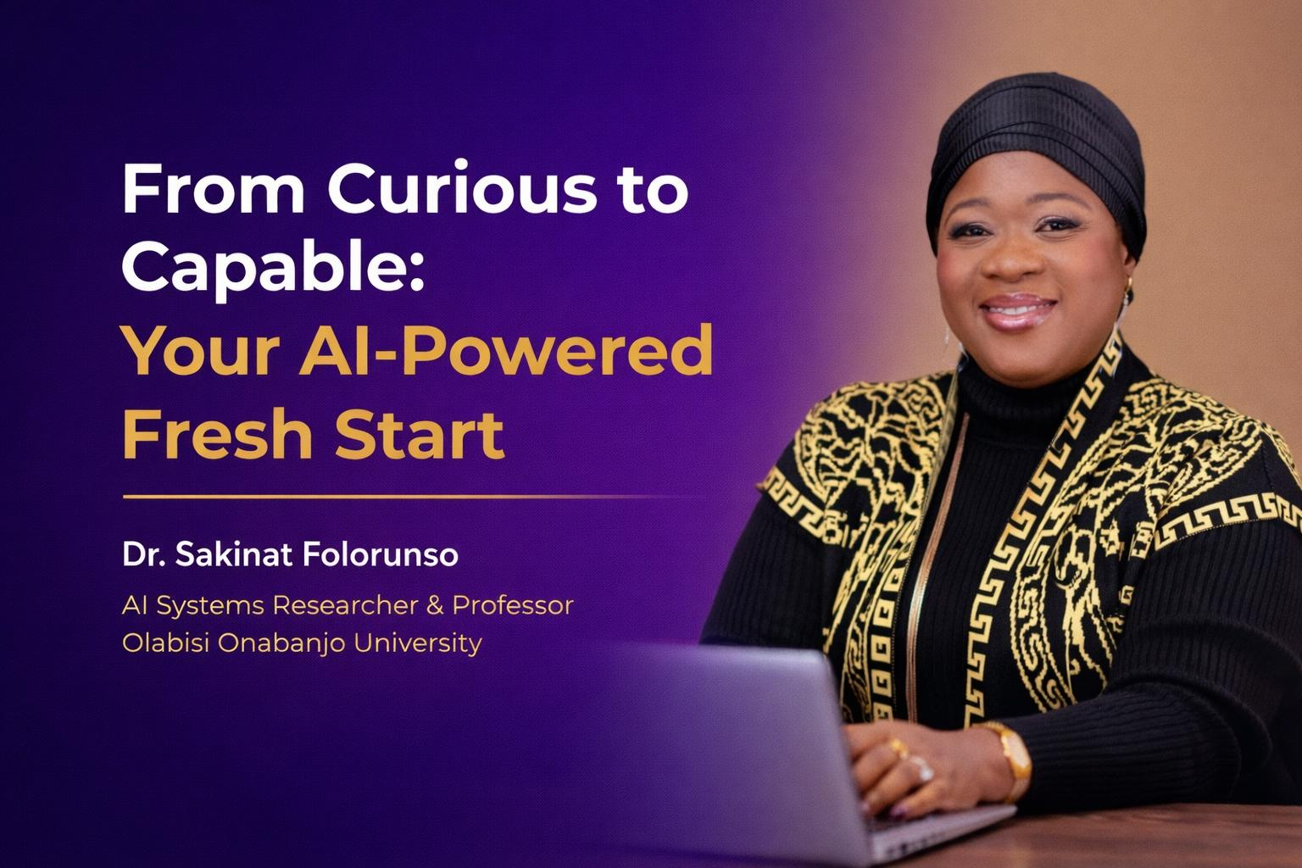
Notes:
Hello everyone! I am so thrilled to be here at the AI For HER Summit. Looking at the theme of 'Learn, Build, Earn,' I wanted to start by acknowledging something: tech can feel like a closed door when you’ve been away, or if you've never coded. Today, we’re opening that door. I’m not here to talk to you as a professor of algorithms, but as a partner in your next career chapter."
Hello everyone! I am so thrilled to be here at the AI For HER Summit. Looking at the theme of 'Learn, Build, Earn,' I wanted to start by acknowledging something: tech can feel like a closed door when you’ve been away, or if you've never coded. Today, we’re opening that door. I’m not here to talk to you as a professor of algorithms, but as a partner in your next career chapter."

Slide 2
The Moment We Are In
AI is already shaping:
Jobs
Businesses
Daily life
The question is not IF — but how you will participate.

Slide 3

What is Artificial Intelligence
Artificial Intelligence = systems that learn patterns from data
and help make smarter decisions.
Think of AI as a fast learning assistant.

Slide 4
You Already Use AI
Movie recommendations
Voice assistants
Fraud alerts
Smart typing
You are already interacting with AI.

Slide 5
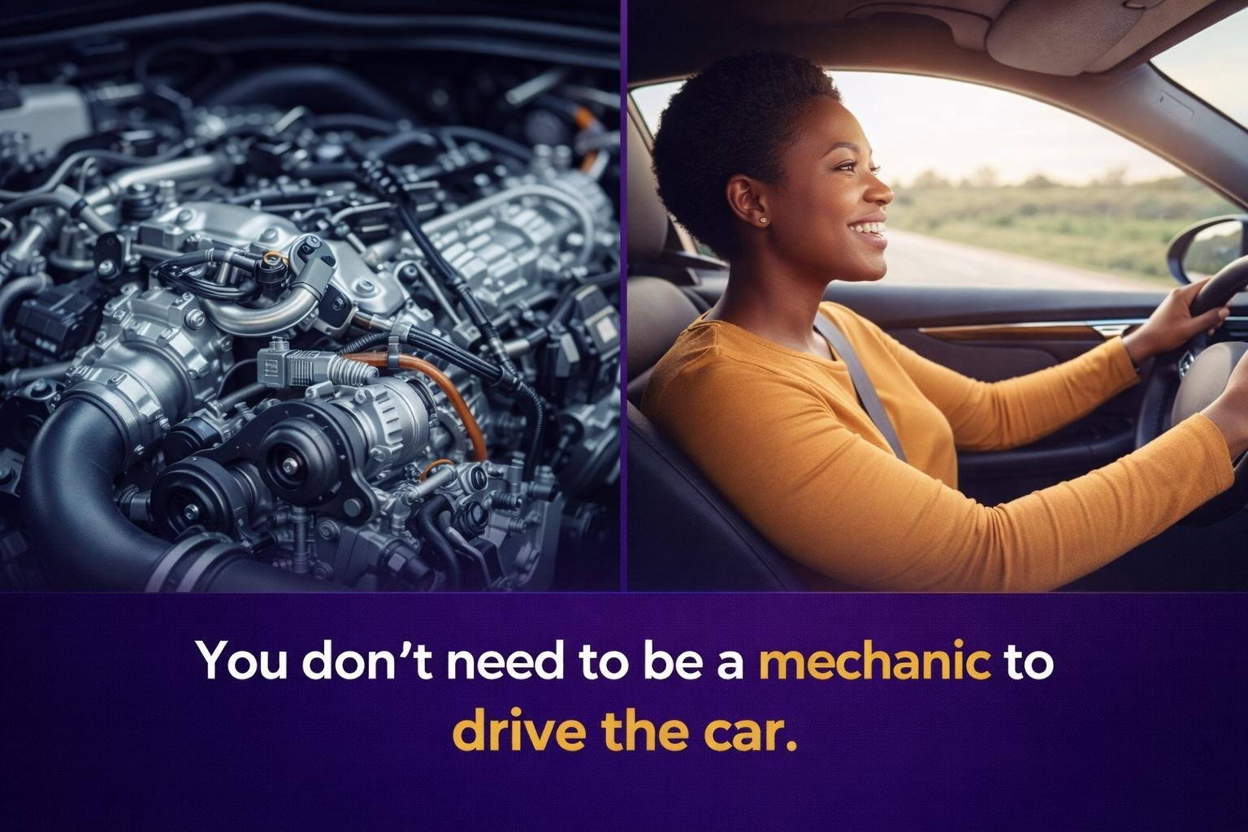
The 'Mechanic' Analogy
Myth: AI is only for programmers
Myth: AI is too technical
Myth: I am too late
Truth: AI has entry points for everyone.
Notes:
People often think they need to understand the 'engine' of AI—the math and the code—to use it. But think about your car. You don't need to know how the fuel injection works to drive your kids to school or get to an interview. AI is the same. It is a vehicle designed to take you where you want to go. My job is to give you the keys."

Slide 6
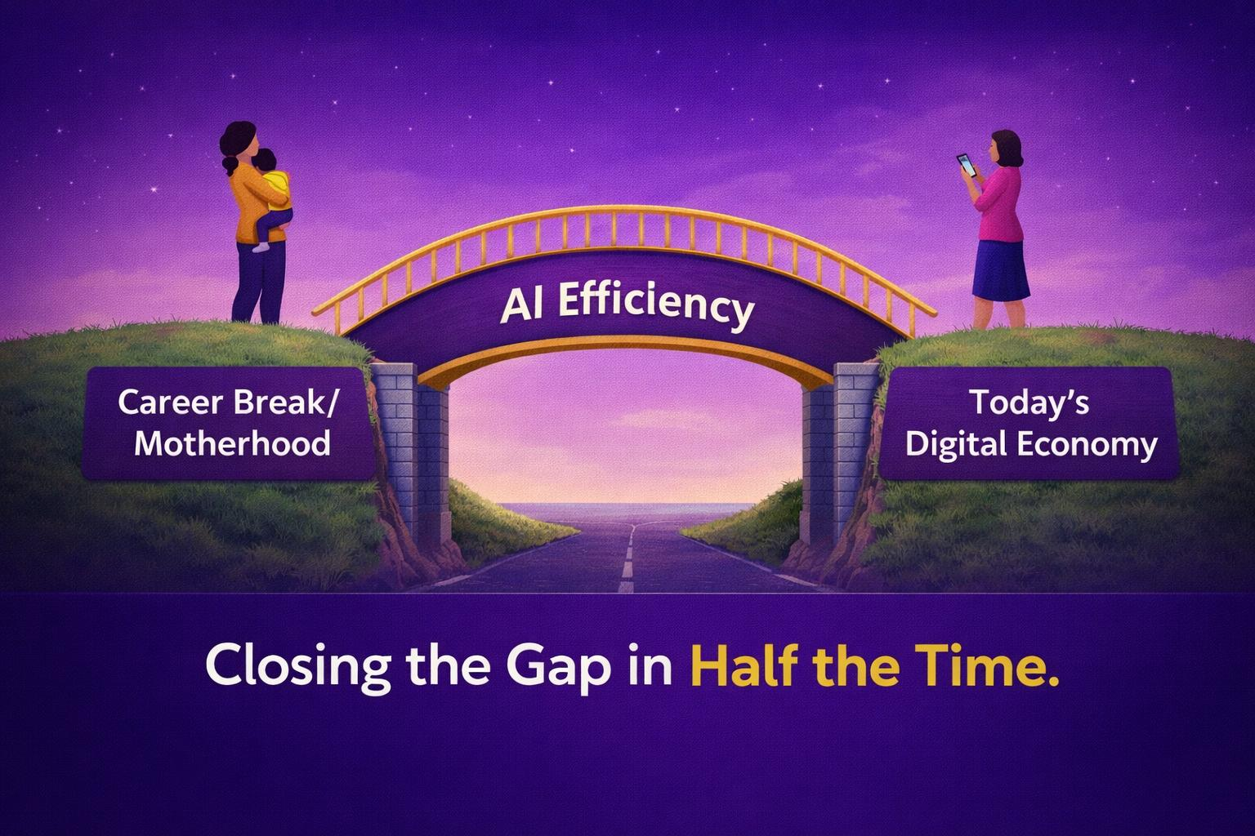
Bridging the Gap (The Career Break)
Notes:
The flyers for this summit mentioned mothers rebuilding clarity and women on career breaks. I know that 'gap' on a CV can feel like a mountain. But AI is the ultimate equalizer. It can help you catch up on industry trends in minutes, draft professional correspondence that sounds like you never left, and automate the tasks that used to take hours. We aren't just returning; we are leapfrogging."

Slide 7

The AI Opportunity Map
1. AI Users
2. AI‑Adjacent Roles
3. Technical Path (Optional)
There are multiple entry points into AI.

Slide 8

Pathway 1: AI Users
Use AI to:
• Write faster
• Create content
• Automate tasks
• Improve business decisions
No coding required.

Slide 9

Pathway 2: AI‑Adjacent Roles
AI project coordination
Data annotation
Prompt engineering
AI product testing
Digital analysis

Slide 10

Pathway 3: Technical Path
If you later choose:
• Data science
• Machine learning
• AI engineering
The door is open — but optional.

Slide 11
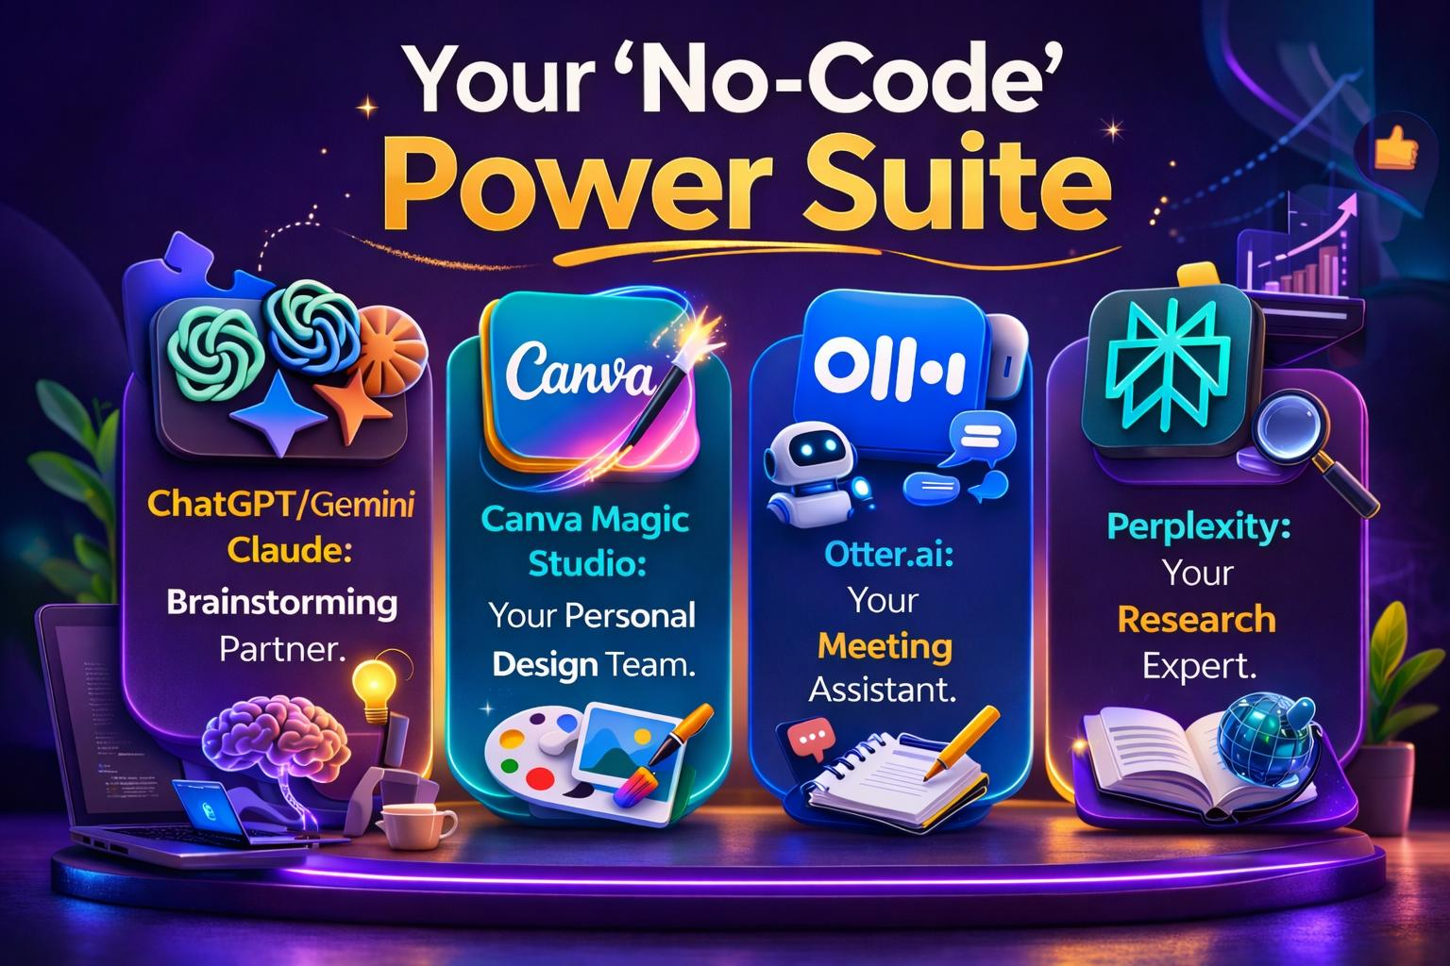
The Non-Tech Toolkit (2026 Edition)
• Verify outputs
• Protect personal data
• Avoid blind trust
• Use AI ethically
Notes:
Let’s look at your new team. You don't need to hire an assistant. Claude or Gemini can draft your business plan. Canva can design your brand. Otter handles the notes while you focus on the conversation. And Perplexity replaces hours of Googling with instant, cited answers. These aren't just 'apps'; they are your new department heads."

Slide 12

The 'Vibe' Over Code
Notes:
In 2026, we talk about 'Vibe Coding.' It sounds fancy, but it just means your vision matters more than your vocabulary. If you can describe what you want—a flyer for a new bakery, a syllabus for a class, a budget for a project—the AI can build the first draft. The 'vibe' is yours; the AI just does the heavy lifting."

Slide 13
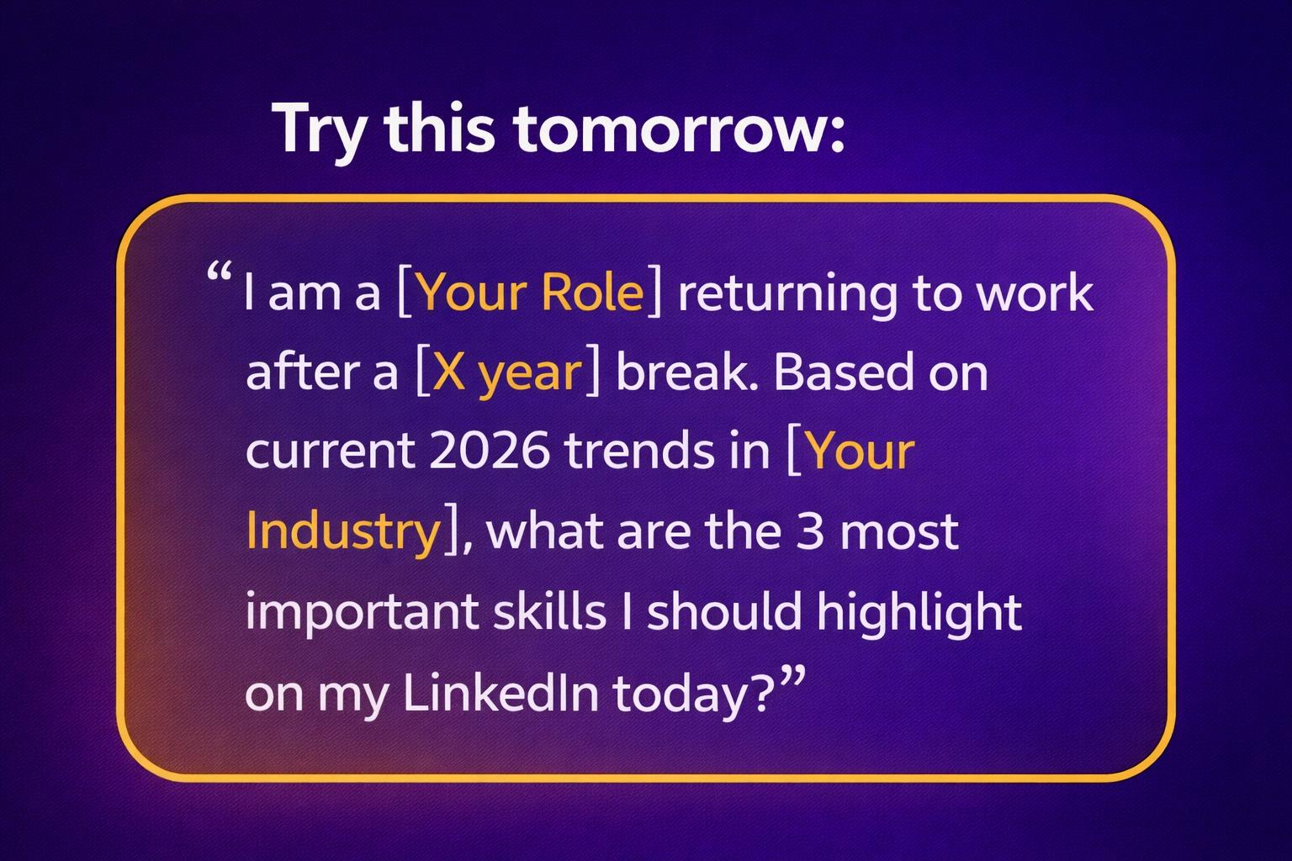
Your First Step: The 'Monday Morning' Prompt
Notes:
Don't wait until you feel 'ready.' Use this prompt tomorrow morning. Let the AI analyze the market for you. This is how you move from curious to capable—one conversation at a time.

Slide 14

Prompts Questions
1. ​"If you could have a digital assistant handle 2 hours of your daily 'admin' work, what would you do with that extra time?“
2. "Who here feels like they’ve been 'away' too long? Let’s talk about how AI is the fastest way to catch up."

Slide 15
7‑Day AI Starter Plan
Day 1: Create an AI account
Day 2: Try one task
Day 3: Improve prompts
Day 4: Apply to work
Day 5‑7: Practice and explore

Slide 16

We Need Your Voice
AI will not replace women.
Women who use AI will outpace those who don’t.
Starting today, that woman can be you.
Notes:
Finally, remember this: The world of AI is still being built. If mothers and non-tech women aren't in the room using it, the technology won't work for us. Your perspective is your superpower. Let's build, let's learn, and most importantly—let's earn. Thank you."

